Slide 1

3D Modelling Part
Örs Márk Varga
&
Richárd Poroszlay

Slide 2
What is this part about?
Create 3D printable models, that can help for people with disabilities
Practice the use of TinkerCAD
Introducing Prusa Slicer
Behind the scenes

Slide 3
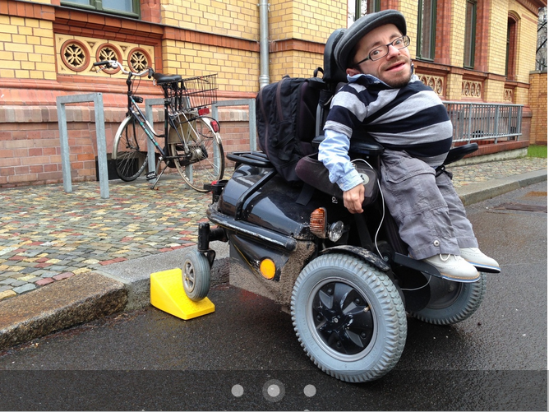
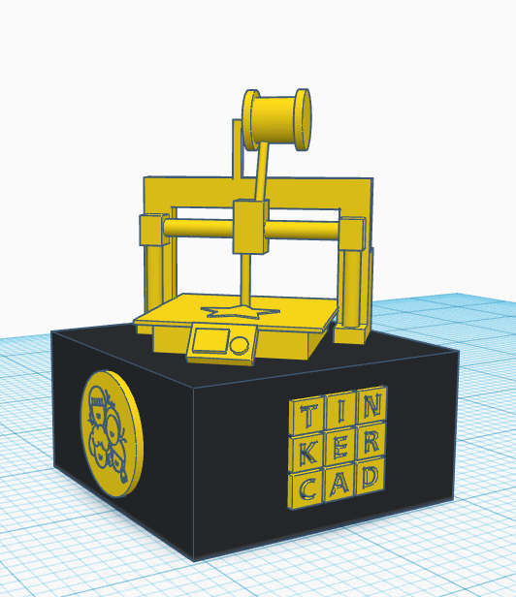
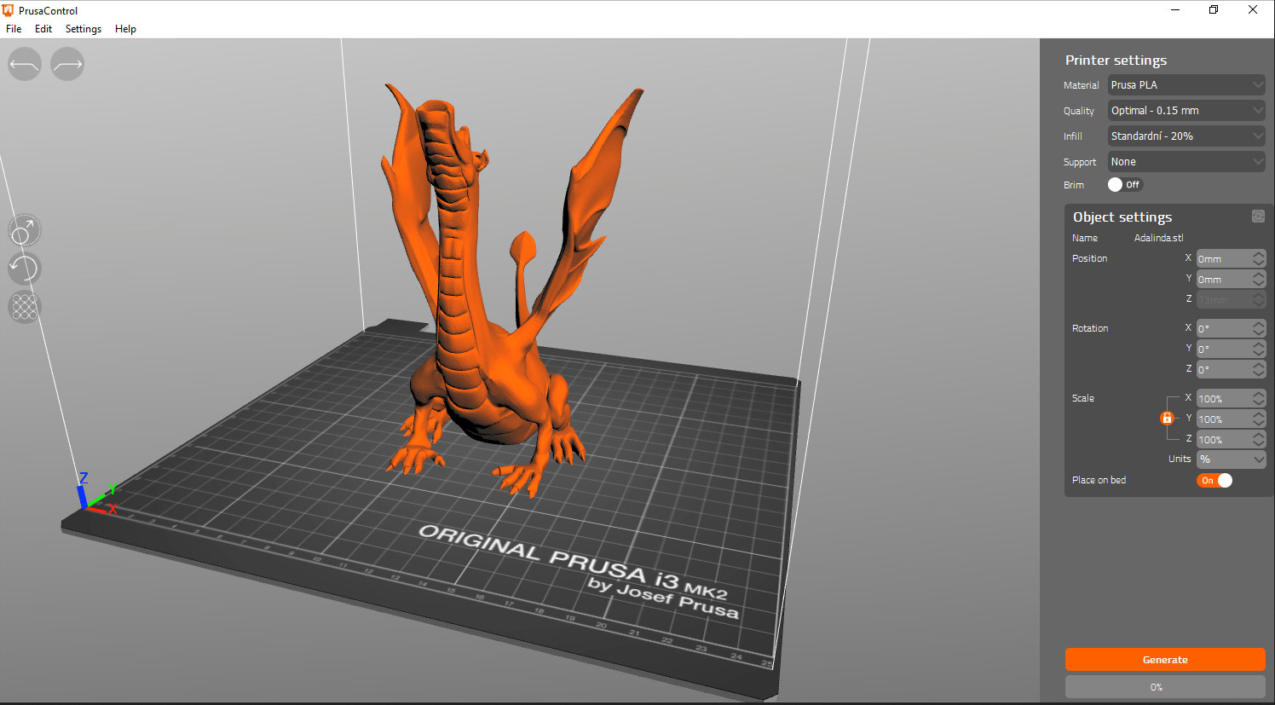

Slide 4
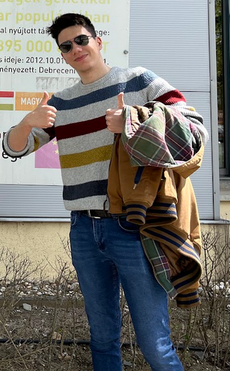
Behind the scenes
We show you how Márk(👑) created the trophies using TinkerCAD
The finished model will be loaded into Prusa Slicer for more details

Slide 5
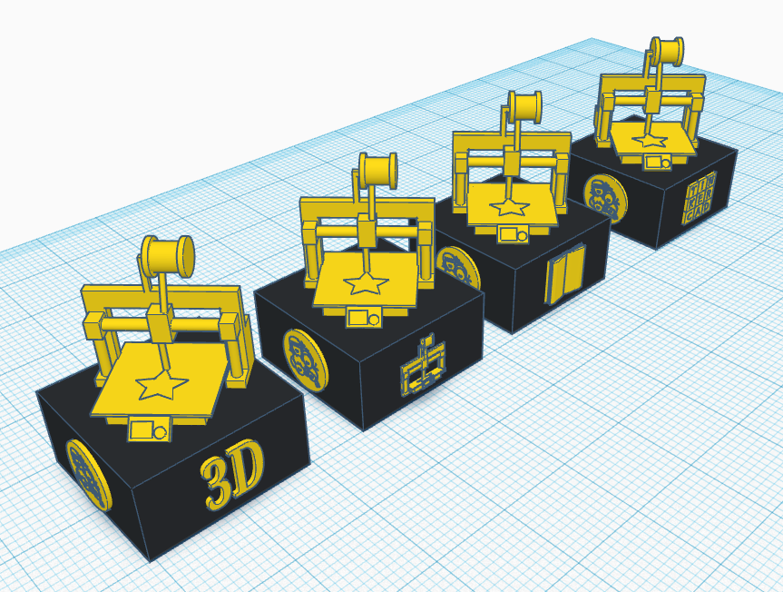

Slide 6
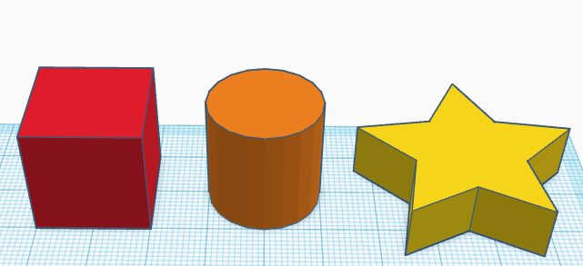
Shapes required for the model
The trophies require only three shapes!

Slide 7
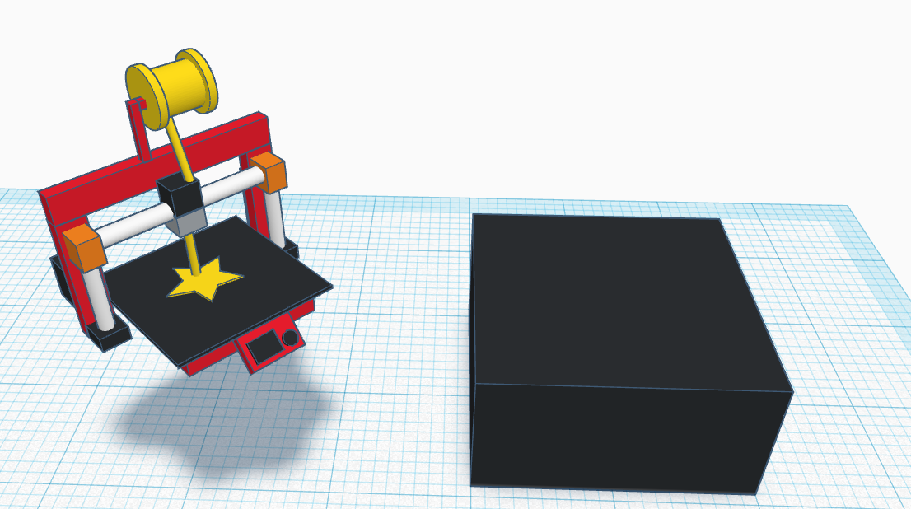
How do these shapes look together?
It’s a beauty, isn’t it?

Slide 8
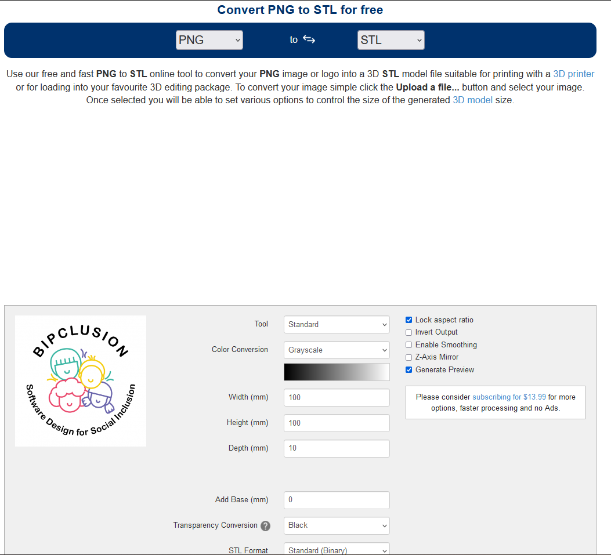


Putting the logo on the trophy
For this, an online converter was used (PNG -> STL)

Slide 9
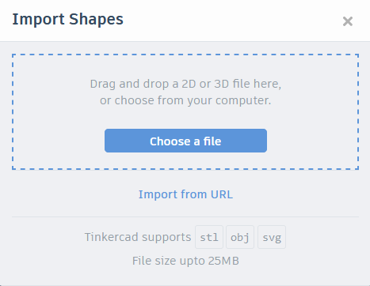
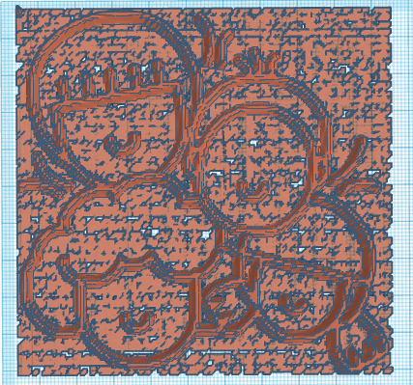

Slide 10
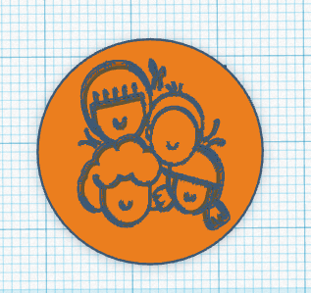
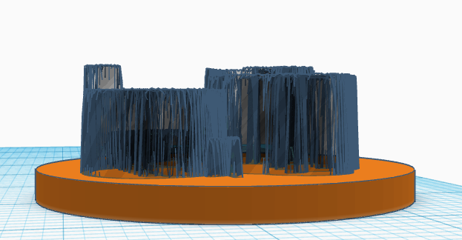
After importing the STL…
…the faces were cut out with a hole
Then the cutted faces were used to hole the logo on a circle

Slide 11
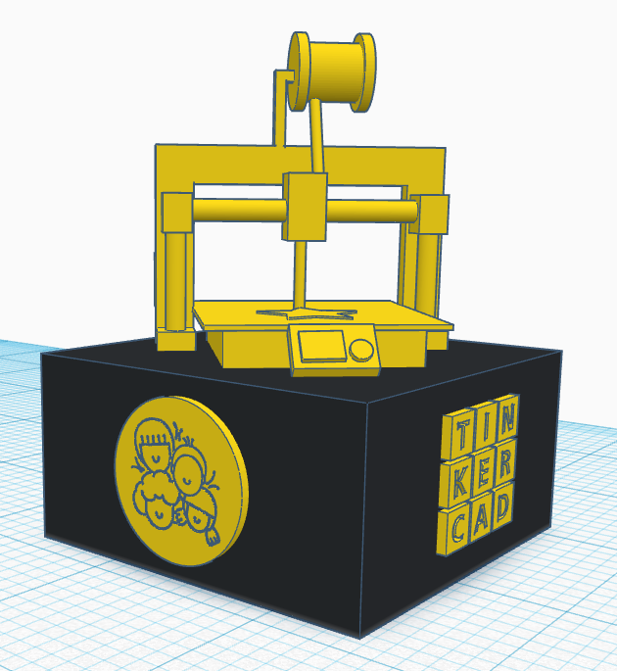
Result
Finally, we put everything together!
Bonus: TINKERCAD logo

Slide 12
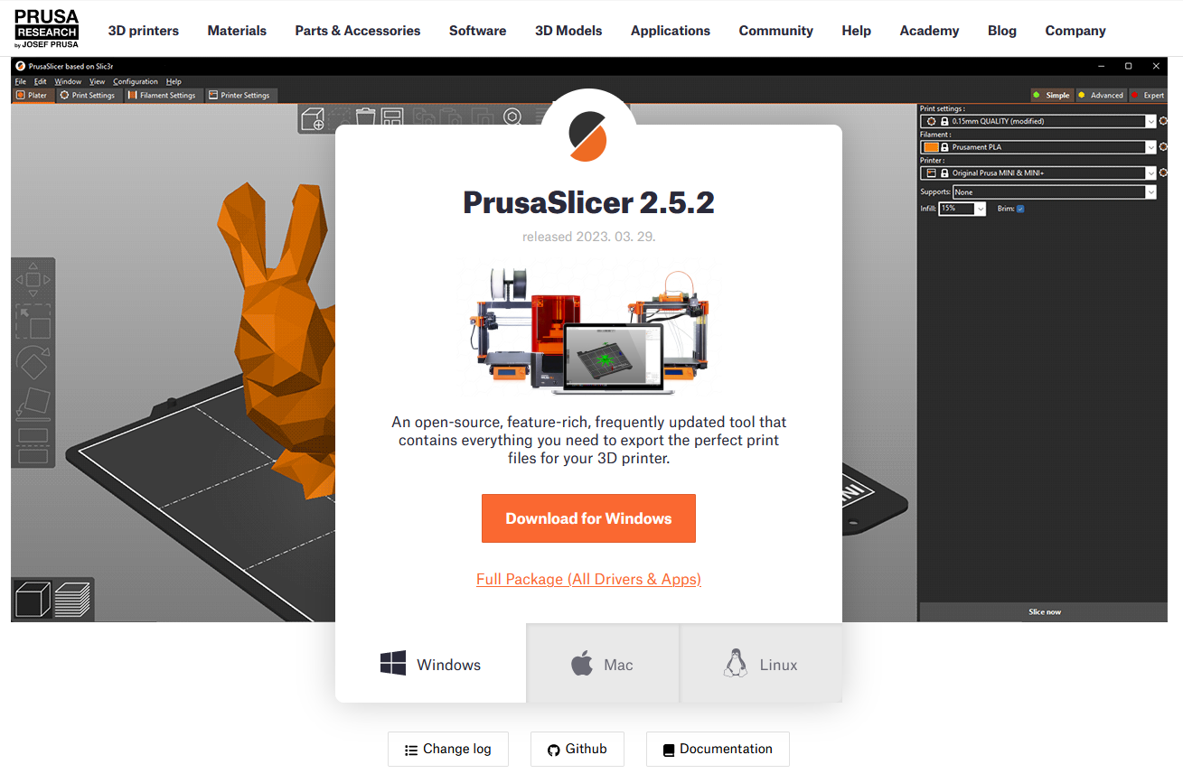
Get into Prusa Slicer

Slide 13
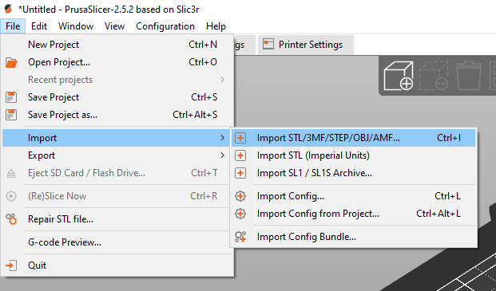
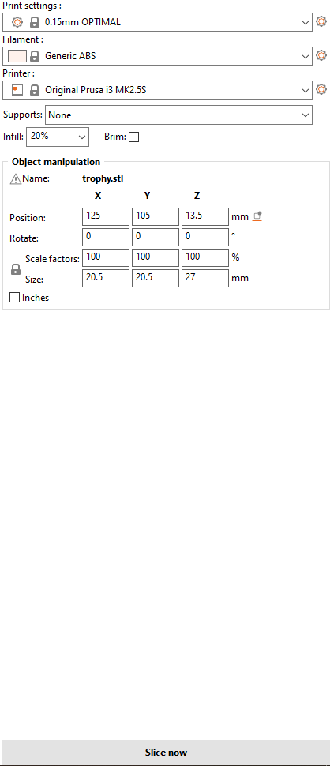
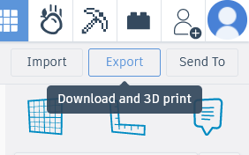
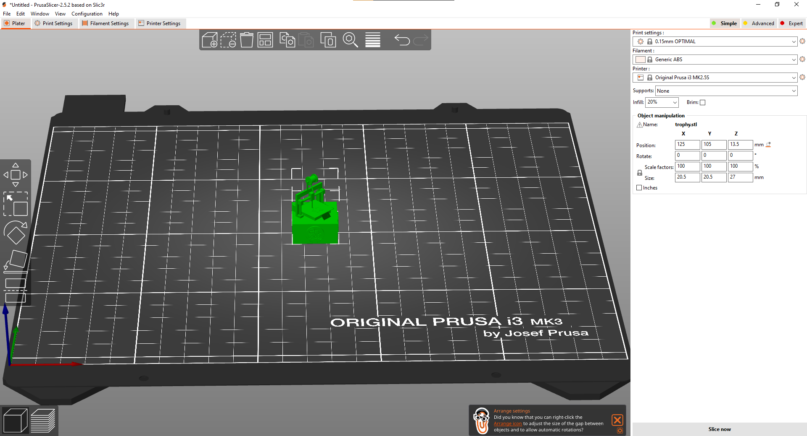

Slide 14
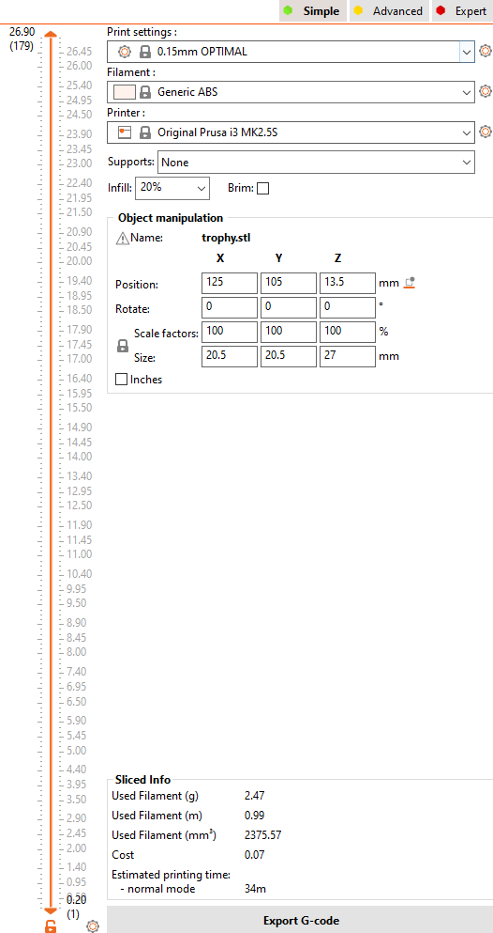
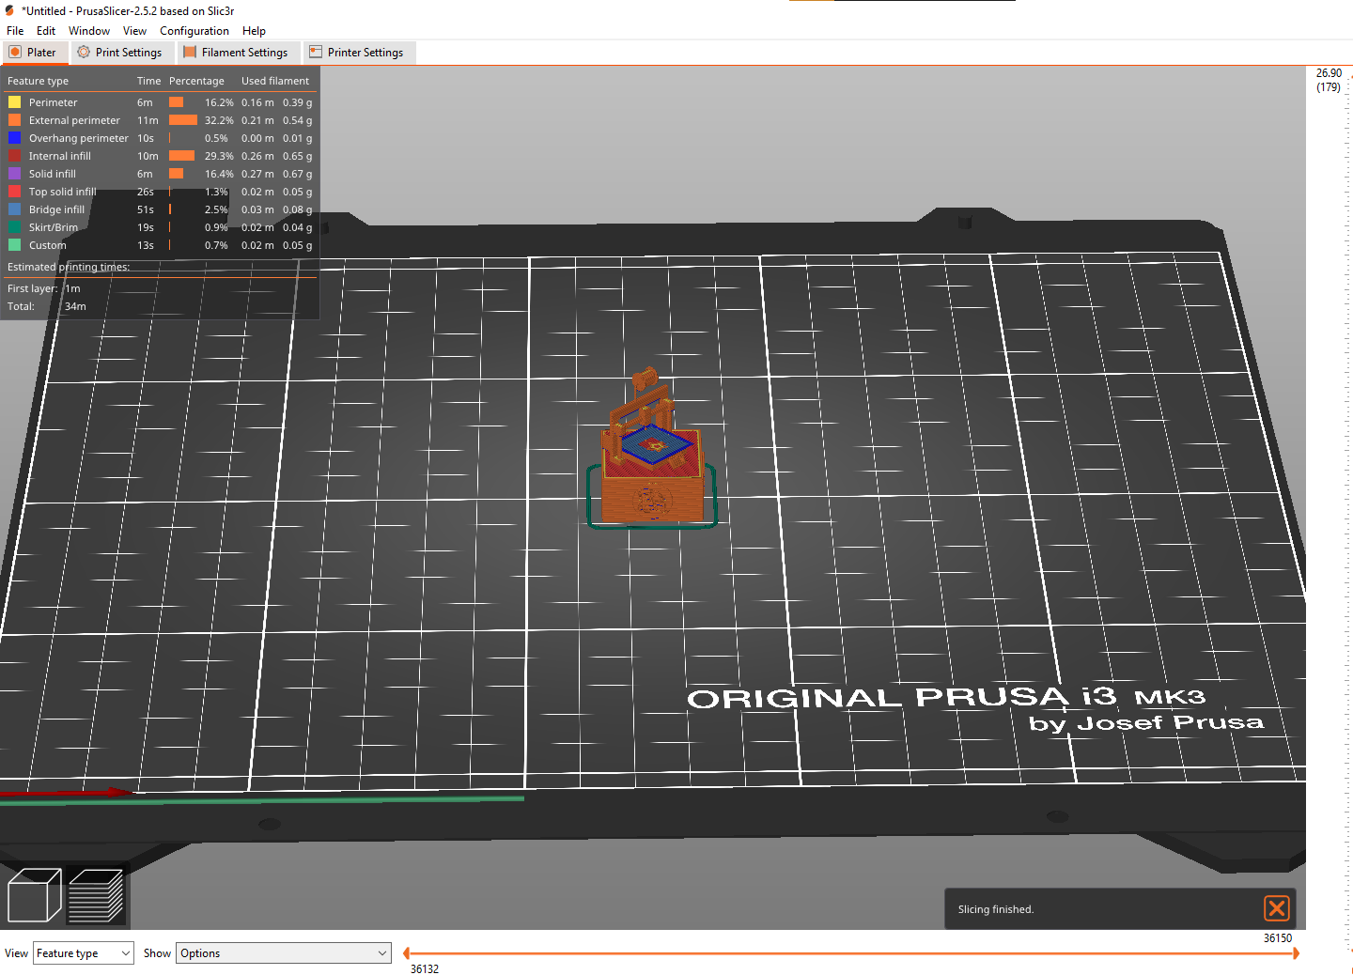

Slide 15
Interactive part
We’ve brought you some simple, but useful projects
We model one of them together
You should make the rest on your own
Competition: the first student who modells the assignments correctly will receive a trophy!

Slide 16
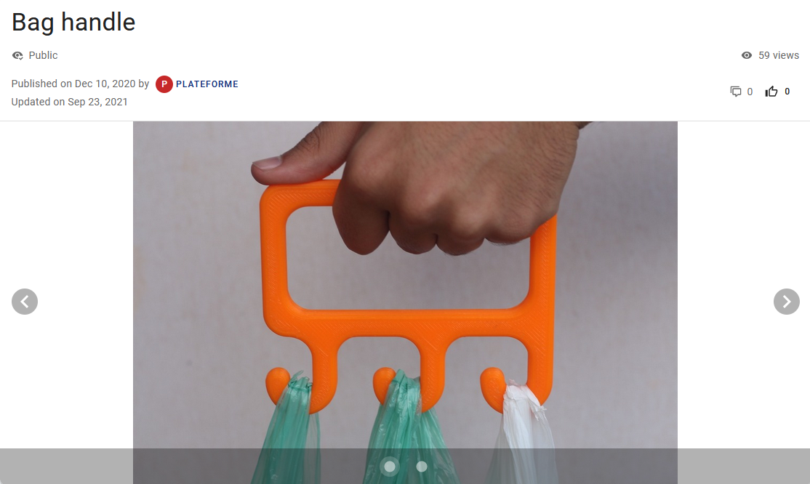
First project: Bag handle

Slide 17
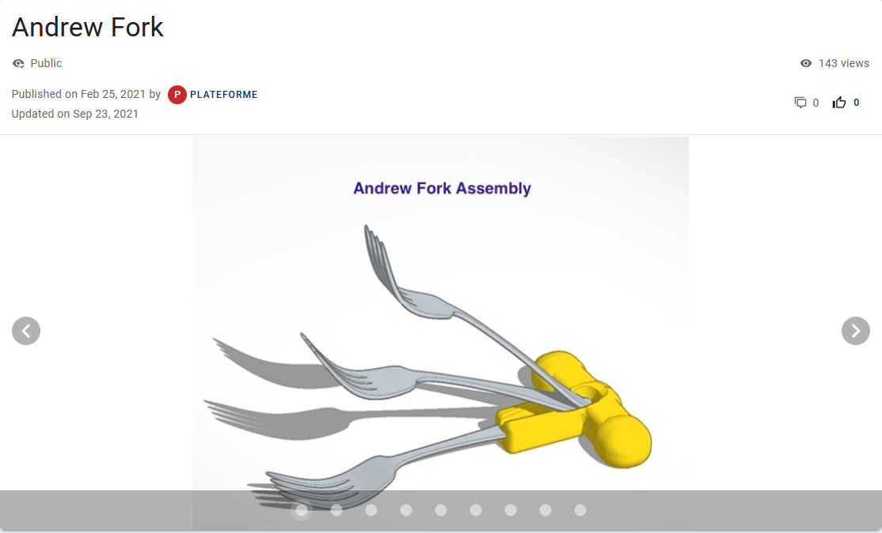
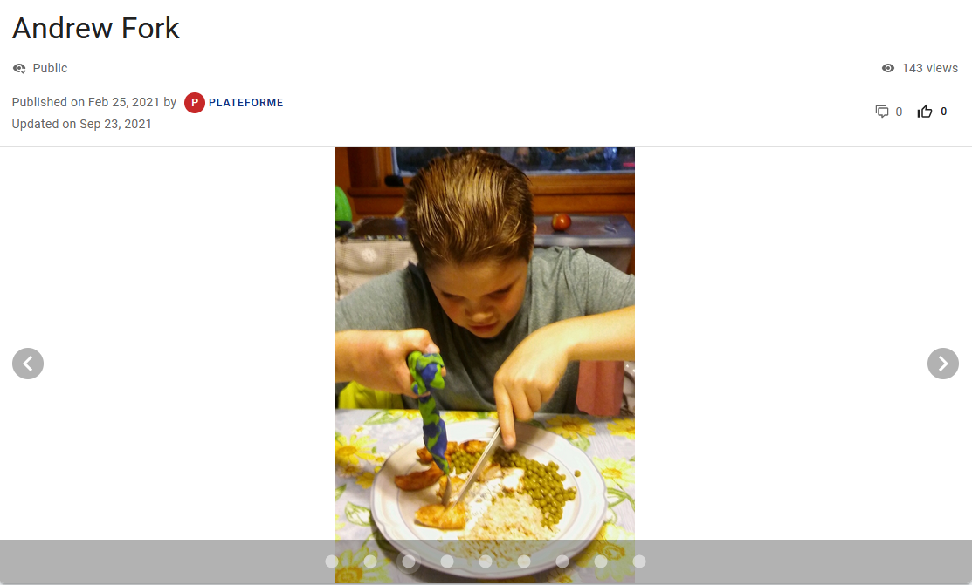
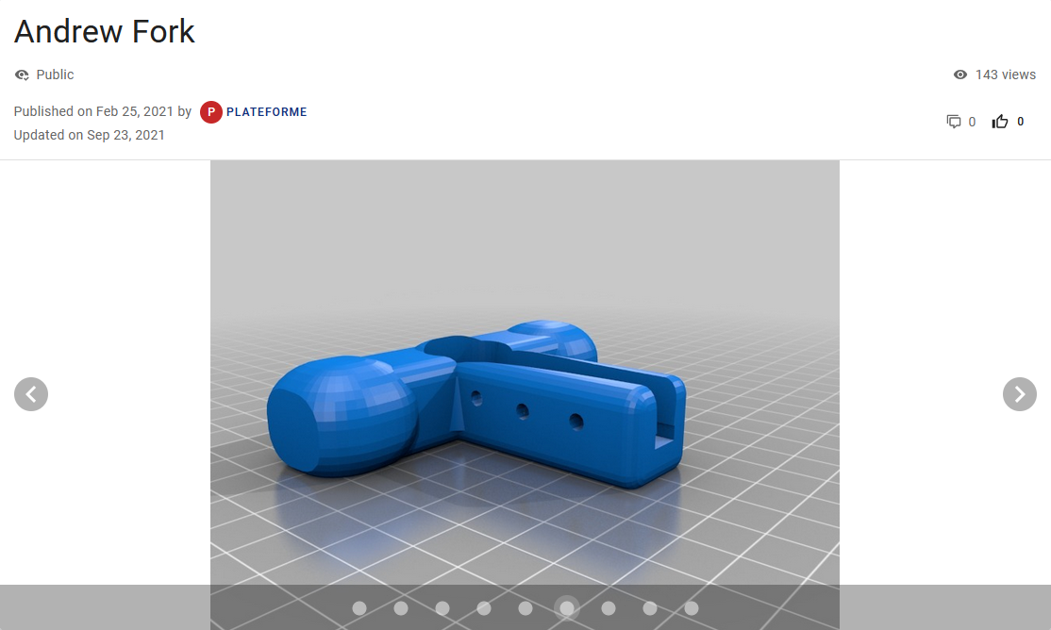
Second project: Andrew’s fork

Slide 18
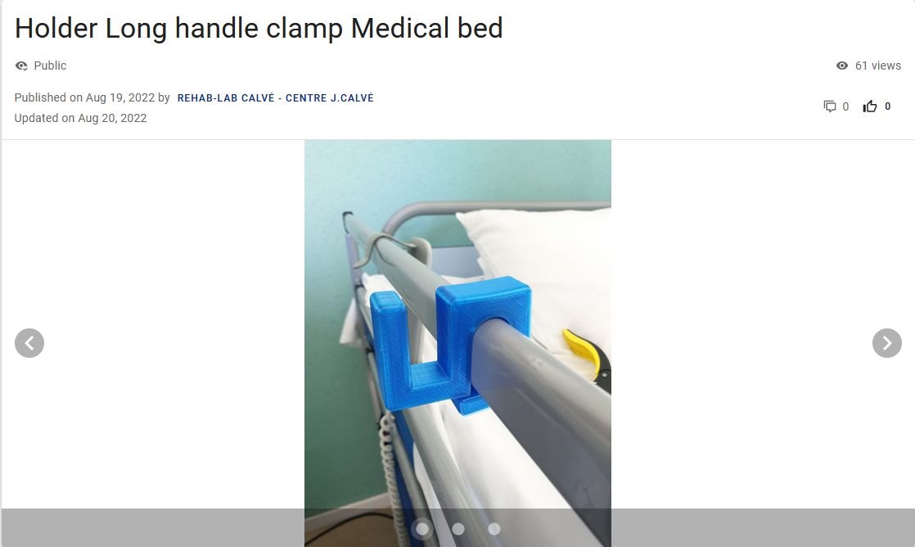
Third project: Holder Long handle clamp Medical Bed

Slide 19
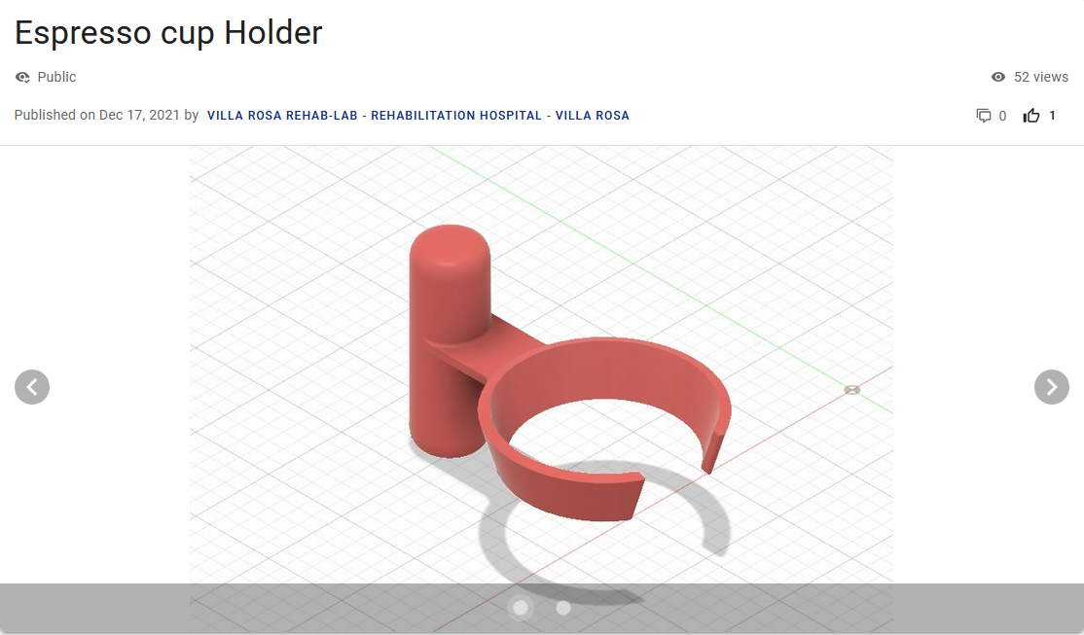
Fourth project: Espresso cup Holder

Slide 20
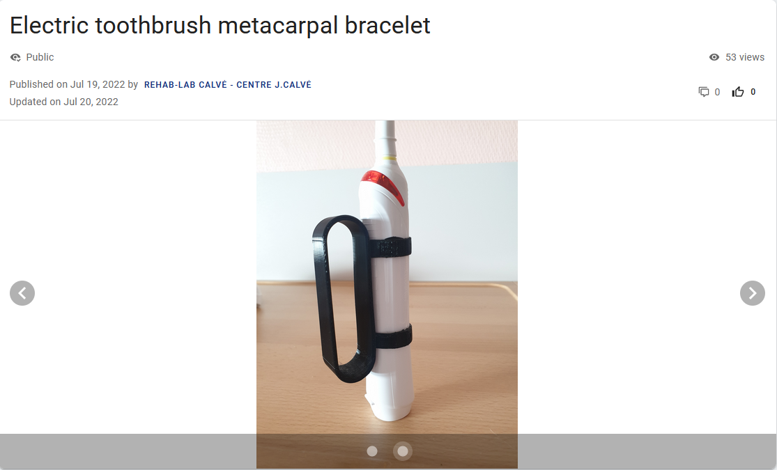
Fifth project: Electric toothbrush metacarpal bracelet

Slide 21
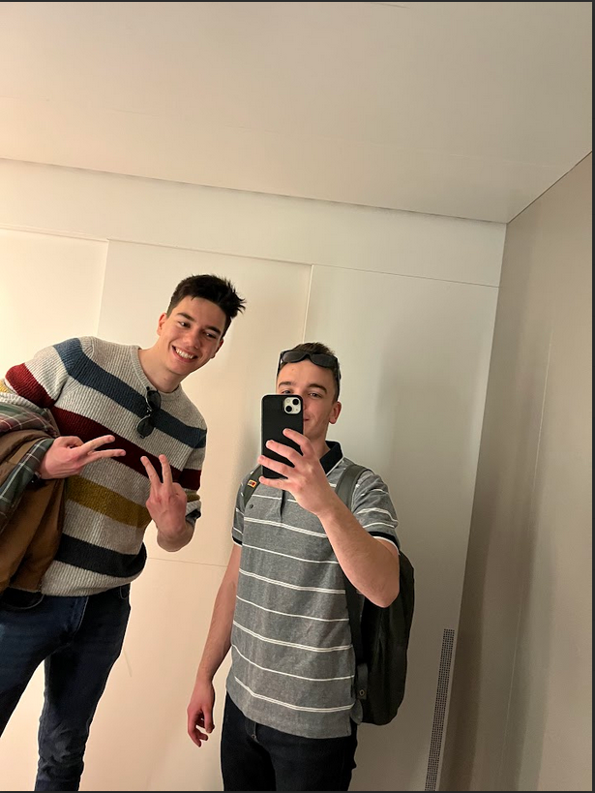
Thank you! ☺

Slide 22
Sources
https://rehab-lab.org/
https://www.tinkercad.com
https://www.prusa3d.com/page/prusaslicer_424/
https://imagetostl.com/convert/file/png/to/stl

